Slide 1
How to Find Work You Love
HIRANYA FERNANDO
4 January 2014

Slide 2
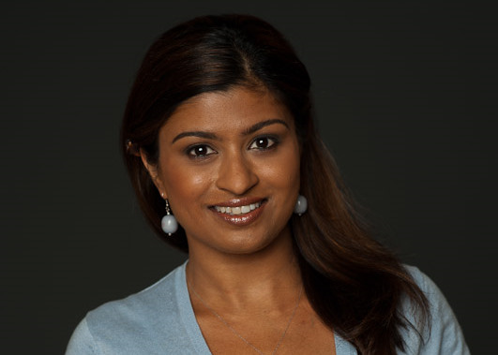
About me
15+ years experience in law, business, finance, international development, research, clean tech
Education: B.Sc. and LLM, London School of Economics; MBA, Wharton Business School (UPenn)
Employers: World Bank, World Resources Institute, Merrill Lynch, Citigroup, Lehman Brothers, AMR Research, Gartner
Founder & CEO, Lumiere: mentoring, counseling, & coaching
Corporate + non-profit jobs
English + French bilingual
U.S. based + international jobs
Notes:
A few quick things about me. My background.. Why am doing this..
And its all part of the story of how I myself found work I love.

Slide 3
Tell Me About You
Why are you here?
Immediate, specific
You don’t like your job (or boss, colleagues, or the industry you work in)
You are in an active job search and need help with CV, LinkedIn, applications etc.
You feel stuck, unmotivated at work, and this is affecting your general happiness
You wish to find more meaning in your work + life.. you want to match your unique talent to the world’s call
Deeper, more complex, longer term
Notes:
All these reasons are Good. Wherever you are at is valid, it is where you are at, and so that is what we work with. What we will cover in our 2 hours together will be helpful no matter what your reason is.
Explain movement of the arrow: the more immediate and specific, to the deeper and more complex.

Slide 4
A third of your life is spent on the job
Your job = 10 out of the 16 hours you are awake.
Asleep
Awake
It’s a problem if you are unhappy during this time.
It’s not just your productivity that is impacted..
The world loses out on your talent
Notes:
About that .. the world is losing out.. If you don’t figure this out, and bring YOU and your gifts to the benefit of the world, its not just you who loses out; THE WORLD LOSES OUT ON YOU.

Slide 5
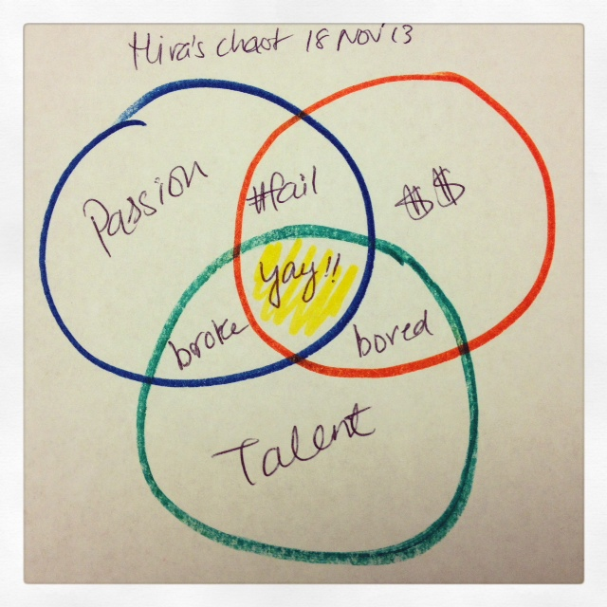
The KEY slide
Need all three:
Passion
Talent
Money

Slide 6
Identifying your natural talent
Childhood- what were you like, what did you like to do?
If /when you get lost in an activity, and don’t notice the time pass by what are you doing?
Ask friends and family, i.e. personal sources (historical reference)
Ask colleagues, bosses, mentors, i.e. professional sources (360 degree reviews, johari window)
Education
Experience
Notes:
What are you good at?
What feels natural?
What is easy/ effortless?
What we are talking about here should go to the core of who you are. What you naturally like to do.. What you always did.. even as a kid.
We are NOT talking about what you have learnt through education or work experience. Education and experience is time spent developing and practicing a skill. The problem here is that our early influencers (parents, school, society) take us down all kinds of paths – good and bad.
Exercise 1: Childhood
Exercise 2: Present day

Slide 7
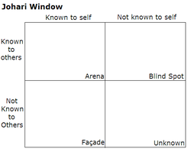
Johari Window
able accepting adaptable bold brave
calm caring cheerful clever complex
confident dependable dignified energetic extroverted
friendly giving happy helpful idealistic
independent ingenious intelligent introverted kind
knowledgeable logical loving mature modest
nervous observant organized patient powerful
proud quiet reflective relaxed religious
responsive searching self-assertive self-conscious sensible
sentimental shy silly spontaneous sympathetic
tense trustworthy warm wise witty
http://kevan.org/johari
Notes:
Another tool that students can use with friends, family, colleagues, peers for external description of “you”.

Slide 8
Identifying purpose
What am I doing with my life?
Does what I do for a living align with a deeper purpose?
What are my core values?
Am I in some way helping others, my community, the world with my talents?
What is worth living for? Why are we here?
Big questions! Doesn’t mean you have to be a philosopher! Simply that to think along these big picture lines is helpful towards identifying what is “fulfilling work” for you.

Slide 9
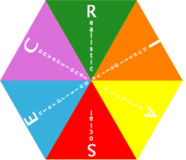
Career assessments and personality tests
Good news: Lots of different tools!
Bad news: Lots of different tools!
Strengths Finder
http://strengths.gallup.com/default.aspx
MBTI & Eneagram
http://www.humanmetrics.com/cgi-win/jtypes2.asp
WCIMP Career Interest Game
http://career.missouri.edu/students/majors-careers/skills-interests/career-interest-game/
Princeton Review Career Quiz
http://www.princetonreview.com/careers-after-college.aspx
Notes:
These are very helpful. Each gives a piece of the puzzle, sheds light.
But not an exact science. Don’t over diagnose!

Slide 10
Strengths Finder 2.0
"Hide not your talents. They for use were made. What's a sundial in the shade?” Benjamin Franklin
Fixing weaknesses vs developing strengths
34 key themes -> discover your top five talents
Career paths and jobs matched to your top talents
Hundreds of strategies for applying your strengths at work, at play, in the community

Slide 11
Myers Briggs: 4 main vectors
Introvertion vs Extraversion
Sensing vs Intuition
Thinking vs Feeling
Judging vs Perceiving
E
N
F
P
Notes:
1. Where, primarily, do you prefer to direct your energy?
If you prefer to direct your energy to deal with people, things, situations, or "the outer world", then your preference is for Extraversion. This is denoted by the letter "E".
If you prefer to direct your energy to deal with ideas, information, explanations or beliefs, or "the inner world", then your preference is for Introversion. This is denoted by the letter "I".
2.How do you prefer to process information?
If you prefer to deal with facts, what you know, to have clarity, or to describe what you see, then your preference is for Sensing. This is denoted by the letter "S".
If you prefer to deal with ideas, look into the unknown, to generate new possibilities or to anticipate what isn't obvious, then your preference is for Intuition. This is denoted by the letter "N”.
3. How do you prefer to make decisions?
If you prefer to decide on the basis of objective logic, using an analytic and detached approach, then your preference is for Thinking. This is denoted by the letter "T".
If you prefer to decide using values and/or personal beliefs, on the basis of what you believe is important or what you or others care about, then your preference is for Feeling. This is denoted by the letter "F".
4. How do you prefer to organize your life?
If you prefer your life to be planned, stable and organized then your preference is for Judging (not to be confused with 'Judgmental', which is quite different). This is denoted by the letter "J”. If you prefer to go with the flow, to maintain flexibility and respond to things as they arise, then your preference is for Perception. This is denoted by the letter "P".

Slide 12
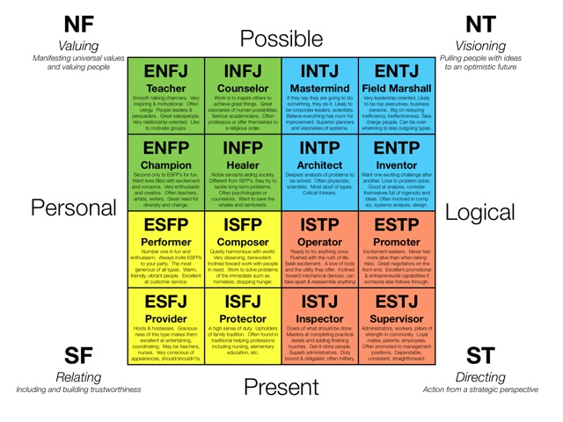
MBTI / Jung 16 Typologies
Notes:
4 temperaments
Green= Idealists
Blue= Rational
Yellow= Artisans
Red= Guardians

Slide 13
Now we are going to switch gears..
Career discovery - talents, skills, strengths
Taking action- practical steps for career switching, following a passion etc..
Notes:
We covered various tools and techniques for discovering who you are + what your strengths and talents are
Now we move into… taking action! How do we take this new information about ourselves and applying it to finding work we love? What are the practical steps we must take?

Slide 14
Having a plan
You don’t have a plan until its written down Example: 6 month career discovery plan
Make the plan
Get resume ready
Make list of people to contact
-Meetings with contacts- round1
-Read, research, gather info
-Send out Resume
-LinkedIn + social networks
-Interview prep
Interview follow-up
Take a test
Take a class
-Start a blog
-X hours of volunteer work
-Re-assess, re-calibrate
Fill gaps
More interviews
Second round of conversations with contacts
Main Goal Met
1) New Job
2) Swtich to new career / industry
3) Complete course, or certification
Plan + contact list made
Research + discovery
3 key outcomes met
Course corrected plan
Main goal accomplished
Notes:
Rule #1 you can’t go anywhere very effectively without a roadmap
Rule #2 its best that the said map is on paper, written down (and not just in your head)
- Figure out first where you want to be 6 months down the road. Visualize it. What does success for you look like at the end of the six months? That’s your vision.
What is the main goal- E.g. 'I would like to be in a new job by Jan 2013'.
Or if there is no one main goal, what are three clear outcomes you would like to see by a certain date. Think of being in Jan 2013, looking back. What have you accomplished?
Now, for a plan to get there… A timeline with clear milestones is the main tool. A good timeline allows you to reverse engineer the process and figure out what you have to do today, tomorrow, and in the next weeks and months to accomplish your vision. This then becomes your mission.

Slide 15
Taking action is critical
Take one small step at a time
Keep going, keep going, keep going
The plan will reveal itself in and through the action that is taken
Doesn’t matter if it turns out to be a ‘wrong’ turn- part of the process
Have conversations, do research, take classes-> you learn, adjust -> take next step
“If you want to know who you are, watch your feet. Because where your feet take you, that is who you are.” Frederick Buechner
Notes:
When you make a start, the universe (and people and resources) converge to make things happen.
Refer to what the students are trying to do- let them know that making a beginning is the most critical thing. And so a clear action like signing up and coming to this class is important (there are those who didn’t/couldn’t).
Good job on that! You are now on your way!
-Break it down (study your plan- break it down even further if necessary)- take one small step at a time. 5 steps add up..
-Nothing happens, nothing gets translated from your head/mind into reality unless you do something. However small.
-Aspirations, inspirations, and good intentions can’t come to life without you doing something
-The road to hell is paved with nothing but good intentions!
Explain quote:
What do you say you want to do VS. what do you actually do? Where does your feet actually take you? Because that is what is happening. That is the reality.

Slide 16
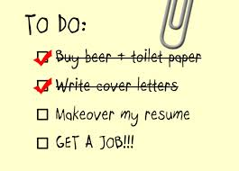
Resumes, bios, LinkedIn summaries
Traditional approaches to creative stunners but don’t ever put form over substance
Convey your best information (skills + accomplishments) in 20 to 40 hard hitting bullet points
P-A-R framework. Focus on the result. What did you accomplish for your employer? Your clients?
Start each bullet with strong action-oriented verbs; keep it succinct, 2 lines max.
Notes:
When you make a start, the universe (and people and resources) converge to make things happen.
Refer to what the students are trying to do- let them know that making a beginning is the most critical thing. And so a clear action like signing up and coming to this class is important (there are those who didn’t/couldn’t).
Good job on that! You are now on your way!
-Break it down (study your plan- break it down even further if necessary)- take one small step at a time. 5 steps add up..
-Nothing happens, nothing gets translated from your head/mind into reality unless you do something. However small.
-Aspirations, inspirations, and good intentions can’t come to life without you doing something
-The road to hell is paved with nothing but good intentions!
Explain quote:
What do you say you want to do VS. what do you actually do? Where does your feet actually take you? Because that is what is happening. That is the reality.

Slide 17
A word on LinkedIn
LinkedIn is not just a ‘networking’ site LinkedIn = a whole new way labor is organized
Means the supply side of the labor market is organized in one place.
You have a place, a ‘home’ to house your skills, experiences, what you offer an employer, a client, a business partner.. the world.
It’s a ‘live bio’: you are now searchable. The market can now find you (and make you can offer.. ultimately pay you $!)

Slide 18
3 key actions when you wake up tomorrow
Review what you learnt today
Locate your resume + sign into your LinkedIn account
Shoot me an email me and tell me you did it
Pick something that is simple, feasible, and realistic
Also pick a results-oriented, impactful action
Golden rule= just move that ball forward one tiny bit
Notes:
Lets each of us write down 3 small things we’ll do tomorrow..
Here’s an example…

Slide 19
3 key actions in the next two week
Two phone calls or meetings set up with 2 people you will speak to about finding work you love - leads, informational interviews, brainstorming, research
Resume updated + set up on LinkedIn and other career networking sites
Buy Strengths Finder and complete the test. Study the careers that are matched to your strengths.
Call me or email me and let me know it’s DONE. ☺
Notes:
Lets each of us write down 3 (bigger) goals we will meet in the next two weeks.
Send me an email on Oct 27th and let me know that you did them.

Slide 20
About Lumiere
Services
Resume writing and review
LinkedIn profile optimization and search strategies
Job application materials and interview prep
Figuring out your unique skills, strengths, and talents
Figuring out next steps, and a long-term plan
Setting goals, milestones, and timelines
Contact us
Ms. Hiranya Fernando
hiranyaf22@gmail.com
www.lumiereworld.com
Colombo mobile: 077 352 1909
U.S. mobile: +1 202 302 3640
Skype: hiranya22
Notes:
Lumiere works to help you understand your own ambition and use your gifts to achieve what you really want in life, not just what others tell you to want.
+ a lot of pragmatic,immediate,actionable stuff.. ☺
+ a support, a motivator, a mentor, someone on your side and by your side throughout this process

